Slide 1

E-Commerce website where convenience meets choice, and shopping becomes an experience

Slide 2

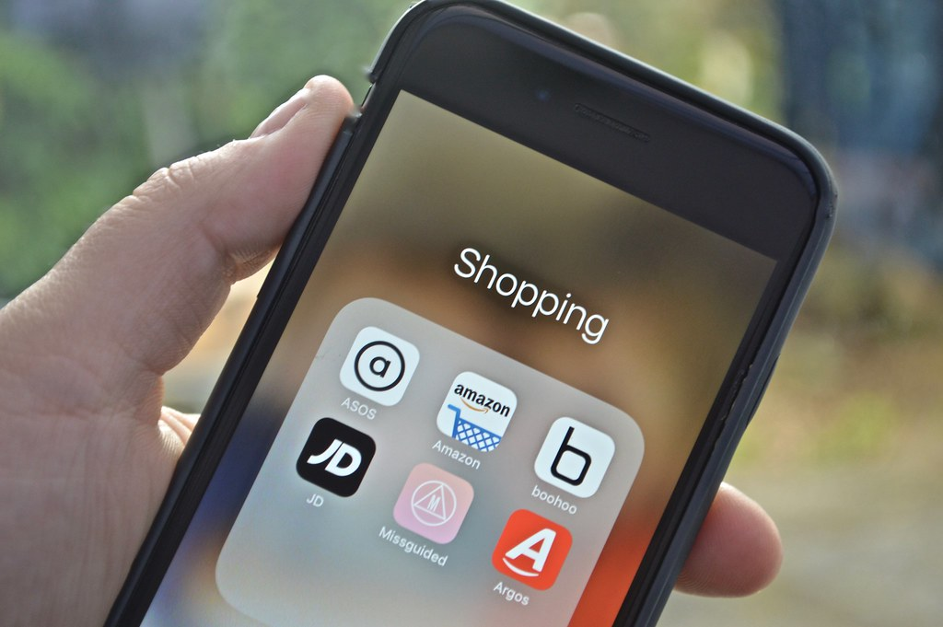
Brief Overview:
This project is an e-commerce website built with HTML, CSS, and JavaScript. Our team has created the core structure using HTML, defining the layout and product information. CSS provides the website's styling and visual design, ensuring a responsive layout across different screens. JavaScript adds interactivity, allowing features like search bars, product selection, and potentially even a shopping cart. Overall, this project demonstrates the combination of these essential web development technologies to create a functional e-commerce experience.

Slide 3
TECHNOLOGY:
HTML: HyperText Markup Language or HTML is the standard markup language for documents designed to be displayed in a web browser. It defines the content and structure of web content. It is often assisted by technologies such as Cascading Style Sheets (CSS) and scripting languages such as JavaScript.
CSS: Cascading Style Sheets (CSS) is a style sheet language used for specifying the presentation and styling of a document written in a markup language such as HTML or XML (including XML dialects such as SVG, MathML or XHTML).^{[1]} CSS is a cornerstone technology of the World Wide Web, alongside HTML and JavaScript.
CSS is designed to enable the separation of content and presentation, including layout, colors, and fonts.^{[3]} This separation can improve content accessibility; provide more flexibility and control in the specification of presentation characteristics; enable multiple web pages to share formatting by specifying the relevant CSS in a separate .css file.

Slide 4
JAVASCRIPT: JavaScript is a scripting or programming language that allows you to implement complex features on web pages — every time a web page does more than just sit there and display static information for you to look at — displaying timely content updates, interactive maps, animated 2D/3D graphics, scrolling video jukeboxes, etc. — you can bet that JavaScript is probably involved. It is the third layer of the layer cake of standard web technologies, two of which (HTML and CSS) we have covered in much more detail in other parts of the Learning Area.
Bootstrap: Bootstrap (formerly Twitter Bootstrap) is a free and open-source CSS framework directed at responsive, mobile-first front-end web development. It contains HTML, CSS and (optionally) JavaScript-based design templates for typography, forms, buttons, navigation, and other interface components.
API Fetching: The fetch API provides a JavaScript interface for accessing and manipulating parts of the protocol , such as requests and responses. It also provides a global fetch ( ) method that provides an easy , logical way to fetch resources asynchronously across the network.

Slide 5
TEAM MEMERS:
Name: Roll No:
Gursimran Kaur 2210990350
Kunisha Dhir 2210990528
Pinak Dhir 2210990650
Pranav Gupta 2210990664

Slide 6
OBJECTIVES:
The objective of our e-commerce project is to develop a user-friendly online platform that enables customers to conveniently browse, select, and purchase products or services. By leveraging HTML, CSS, and JavaScript technologies, our goal is to create an intuitive and visually appealing website that enhances the overall shopping experience for users.
Specifically, our objectives include:
User-Friendly Interface: Designing a responsive and intuitive user interface that ensures easy navigation and seamless interaction for visitors across various devices.
Shopping Cart Functionality: Developing a functional shopping cart system that allows users to add/remove items, view order summaries, and proceed to secure checkout seamlessly.
Secure Payment Processing: Integrating secure payment gateways to facilitate safe and reliable transactions, ensuring customer trust and confidence in the purchasing process.

Slide 7
4.Order Management: Implementing an efficient order management system to track orders, update order statuses, and provide customers with real-time order updates and notifications.
5.Responsive Design: Ensuring that the website is optimized for various screen sizes and devices, providing a consistent and enjoyable user experience regardless of the device being used.
6.Scalability: Building a scalable architecture that can accommodate growth in both product offerings and user traffic, ensuring the website remains robust and reliable as the business expands.
By accomplishing these objectives, we aim to create a compelling e-commerce platform that not only meets but exceeds the expectations of our customers, ultimately driving sales and fostering long-term customer relationships.

Slide 8
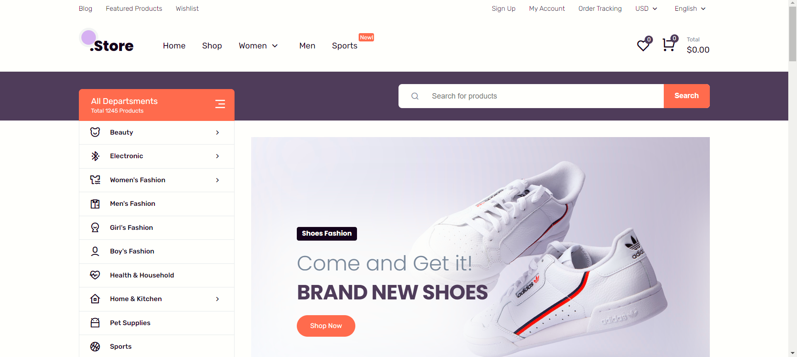
Results:

Slide 9
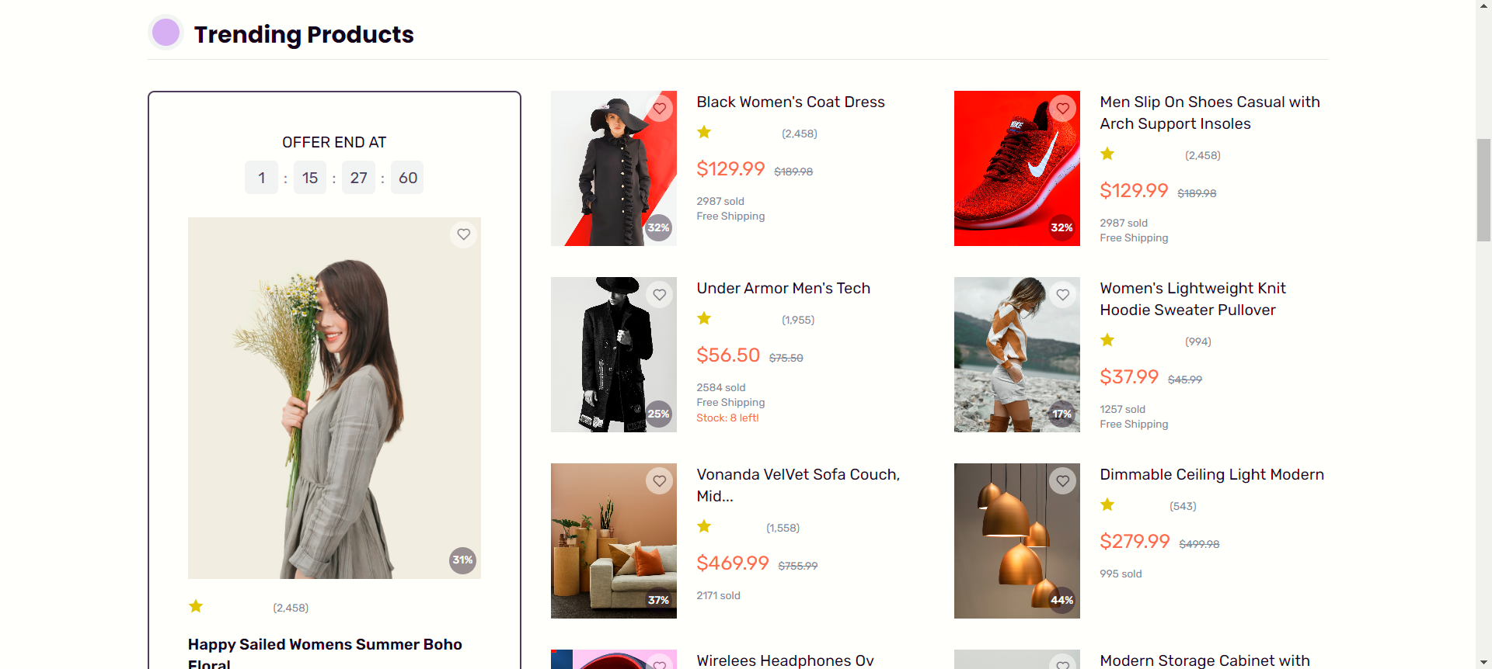
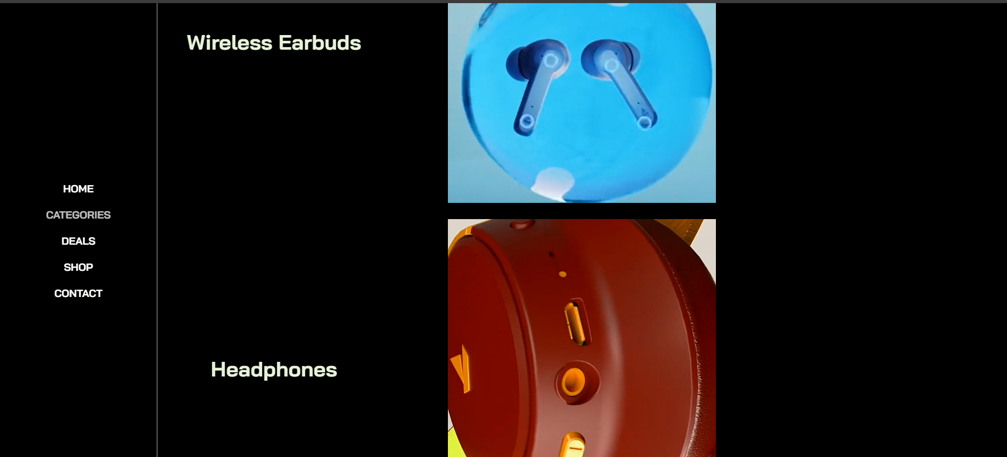

Slide 10
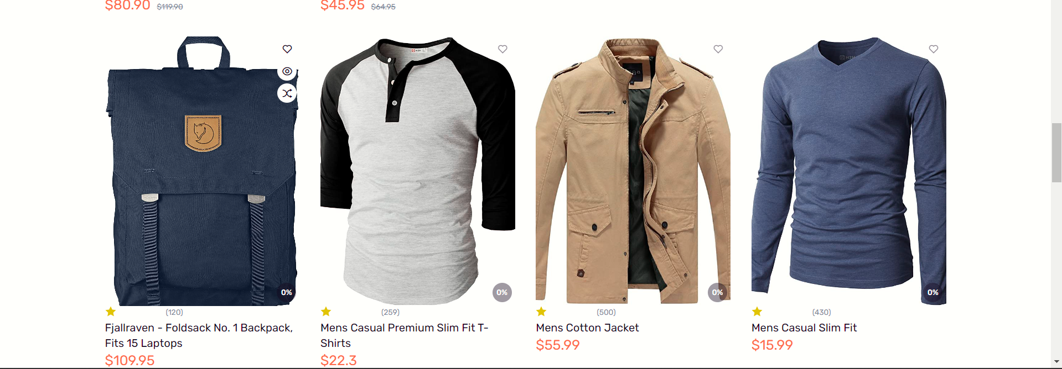

Slide 11
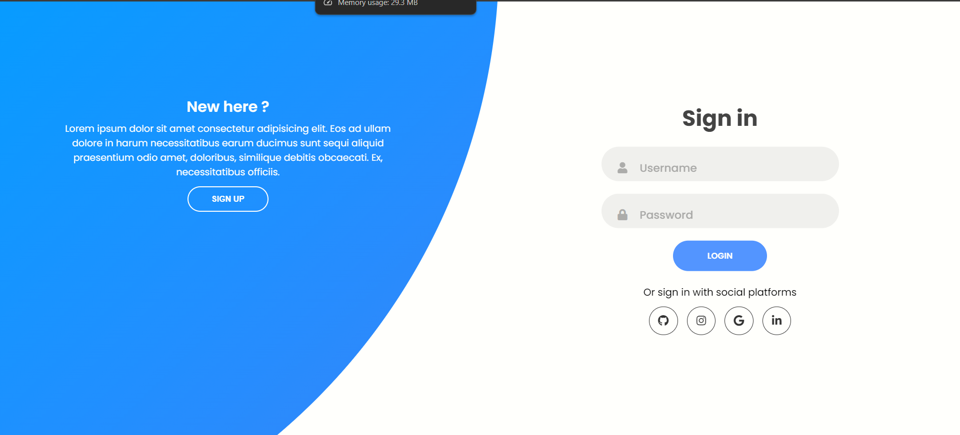

Slide 12


